Slide 1


Data Driven Investigation into Mental Health in South Korea
Datathon Group Presentation
2nd December 2022
For the Ministry of Health and Welfare
Notes:
Ladies and gentlemen, representatives of the South Korean Ministry of Health and Welfare, welcome, and thank you for joining us today. We at the University of Edinburgh have spent the past 10 weeks analysing data regarding Korean mental health care provision. This evening, we will share some of our key data-driven insights and evidence-based recommendations, which we believe will benefit both Korean mental health service users AND the Ministry of Health and Welfare.

Slide 2
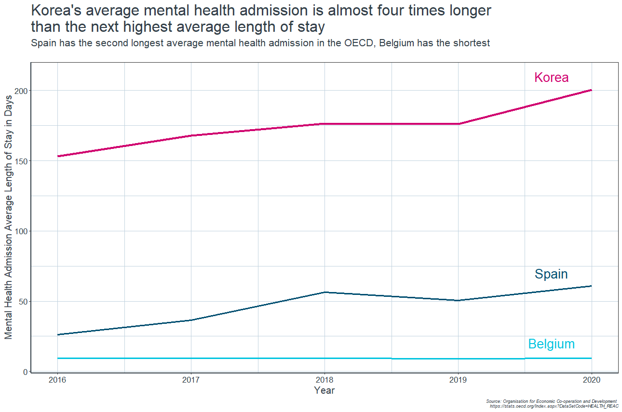
Introduction
The
concern
Root causes
Course of action
We recommend
Success
4x higher length of stay
Long psychiatric admissions suggest mental health care reform is needed in South Korea
Notes:
We will begin with this figure, which demonstrates one of of our key findings.
This graph represents the average length of stay for mental health admissions across countries in the OECD - that is, the Organisation for Economic Co-operation and Development. Across the last five years of available data, Korea has had by far the longest mental health admissions, with an average length of stay of over six months.
For reference, this is almost 4 times higher than the next longest psychiatric admissions, which are found in Spain. Belgium had the shortest stays, lasting barely over a week. With 33 other countries in the data set having an average length of stay between 9 and 60 days, Korea’s 200 day admissions are a clear outlier.
Such long admissions could mean one of two things - either the patients need prolonged, intensive treatment because of how unwell they are; or, they don’t need such long admissions, and something is going wrong which keeps them in hospital inappropriately. [text box] Either explanation would suggest a crisis brewing in Korean mental health care which we cannot afford to ignore.
Whilst other countries have been improving on developing and implementing care in mental health-> SK is still high at its current levels and isn’t changing for the better
Significantly higher LoS of all time
Accompanied by also significantly higher suicide rate
Leading us to address that there is a mental health crisis in SK-> why we are here presenting to the Ministry of Health and Welfare of South Korea and concern cannot be ignored

Slide 3
Introduction
The
concern
Root causes
Course of action
We recommend
Success
Mental health today
4th
leading cause of death is suicide among 15-29 year olds
13%
<2%
rise in mental health conditions since 2017
goes to mental health from government health expenditure
~25%
individuals in South Korea suffer from a mental disorder
(World Health Organization, 2022)
(Nagar, 2022)
Notes:
Why mental health:
Rising at 13%
WHO
increasing acknowledgement of the important role mental health plays in achieving global development goals-> Sustainable Development Goals
Link between mental and physical health with its impact is at its clearest
Depression is one of the leading causes of disability
Suicide is the fourth leading cause of death among 15-29-year-olds.
People with severe mental health conditions die prematurely – as much as two decades early – due to preventable physical conditions
Remains gap between people needing care and those with access to care remains substantial.
-> need to increase investment and know where
= with DDI- can identify this gap and examine where further in investment needed

Slide 4
Introduction
The
concern
Root causes
Course of action
We recommend
Success
Root causes
1
2
3
Poor mental health funding
Inadequate outpatient services
Profit-maximising payment system
South Korea continues to be one of the countries with the lowest percentage of funding allocated to Mental Health services, despite its yearly rise
Outpatient services receive very little funding in proportion to inpatient services, so patients are often are admitted for inpatient services in order to receive adequate care
Health care providers are reimbursed for Medical Aid patients, and are incentivised to keep them admitted to maximise profits
(Roh et al., 2016), (Kim, 2017)
Notes:
The mental health R&D funding in Korea only accounts for 2.7 % of total funding on R&D, compare to US which has approximately 9.8 % of total funding on R&D
The stigma toward psychiatric illness is so serious that most families are reluctant to take care of psychiatric patients at home or at a community health center (Lee et al., 1998).
Both the quantity and quality of healthcare are neither wellassessed nor well-managed.

Slide 5
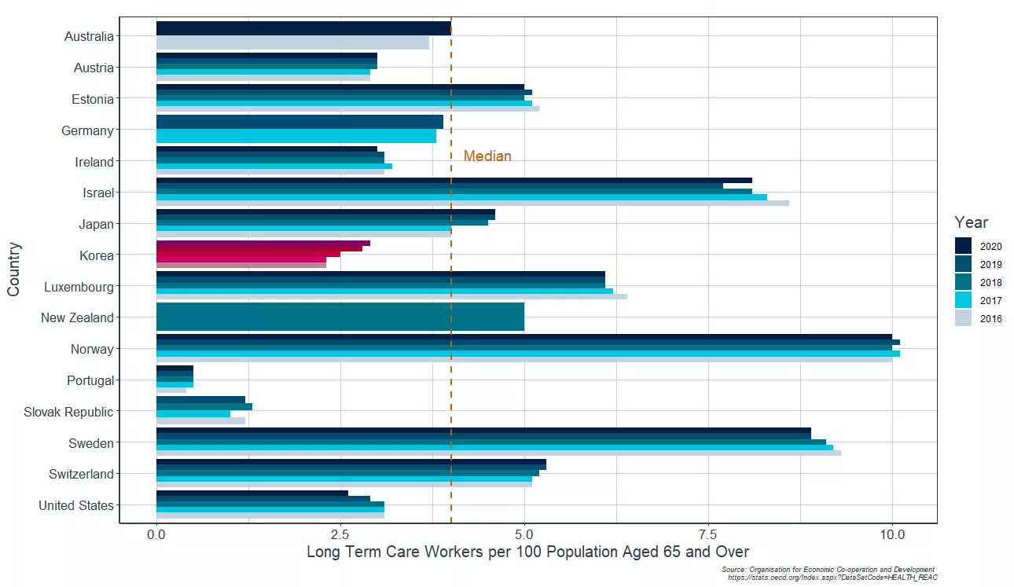
Inadequate outpatient services
Introduction
The
concern
Root causes
Course of action
We recommend
Success
South Korea has substantially fewer outpatient community care workers per capita than the OECD median

Slide 6
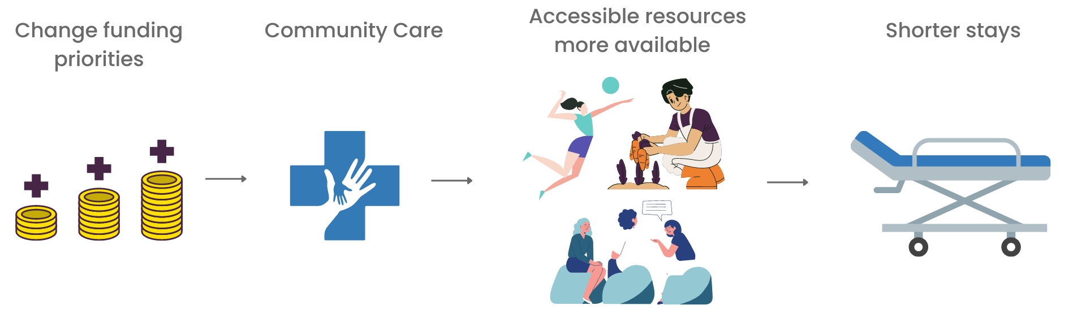
Introduction
The
concern
Root causes
Course of action
We recommend
Success
Course of action
(Roh, et al., 2016), (Kim, 2017), (Jong, et al., 2019)
Notes:
Because the Korean family structure has changed from large families to small ones, fewer psychiatric patients receive care from their family members (Chung, W. et al., 2009).

Slide 7
Introduction
The
concern
Root causes
Course of action
We recommend
Success
We recommend
Flexible Assertive Community Treatment (FACT):
Goal is to become independent and integrate into the community as individuals experience recovery
Will reduce reliance on hospitals by helping with recovering and providing long-term and consistent care
Digital support platform used to send automatic text messages to remind participants of the sessions
FACT involves:
Psychoeducation
Recovery planning
Shared decision making
Composing a crisis plan
Drug-therapy adherence monitoring
Resocialization activities
Family interventions
Sports and lifestyle interventions
(Jong, et al., 2019)

Slide 8

Introduction
The
concern
Root causes
Course of action
We recommend
Success
Success demonstrated
Germany, 2006
Netherlands, 2019
Munich Psychosis Information Project took place which included FACT
Rehospitalisations during 12-month follow-up were approximately 50% lower in the intervention group than in the control group
(Pitschel-Walz, et al. 2006)
Mean length of stay per patient was 15.2 (intervention group) and 34.6 (control group). This represents a statistically significant difference of 19.4 days (56.1%)
Mean total mental healthcare costs per patient were €21,098 in the intervention group) versus €25,054 in the control group, a difference of about €4000 per patient (16%) (Jong, et al., 2019)
England , 2016
German programme was adopted and implemented in England as the Maintaining Adherence Programme
In-patient bed days significantly reduced by 42% (Lewis, et al. 2016)

Slide 9
Introduction
The
concern
Root causes
Course of action
We recommend
Success
References
Bond, G.R. et al. (2001) “Assertive community treatment for people with severe mental illness,” Disease Management and Health Outcomes, 9(3), pp. 141–159. Available at: https://doi.org/10.2165/00115677-200109030-00003.
de Jong, M.H. et al. (2019) “An intensive multimodal group programme for patients with psychotic disorders at risk of rehospitalization: A controlled intervention study,” BMC Psychiatry, 19(1). Available at: https://doi.org/10.1186/s12888-019-2229-x.
Kim, A.M. (2017) “Why do psychiatric patients in Korea stay longer in hospital?,” International Journal of Mental Health Systems, 11(1). Available at: https://doi.org/10.1186/s13033-016-0110-6.
Mental health. World Health Organization. World Health Organization. Available at: https://www.who.int/health-topics/mental-health#tab=tab_1 (Accessed: November 24, 2022).
Nagar, S. (2022) The struggle of mental health care delivery in South Korea and Singapore, Harvard International Review. Harvard International Review. Available at: https://hir.harvard.edu/the-struggle-of-mental-health-care-delivery-in-south-korea-and-singapore/#:~:text=95%20percent%20of%20South%20Koreans,40%20South%20Koreans%20commit%20suicide. (Accessed: November 28, 2022).
Park, S. et al. (2020) “Nurse staffing and health outcomes of psychiatric inpatients: A secondary analysis of National Health Insurance Claims Data,” Journal of Korean Academy of Nursing, 50(3), p. 333. Available at: https://doi.org/10.4040/jkan.19203.
Roh, S. et al. (2016) “Mental Health Services and R&D in South Korea,” International Journal of Mental Health Systems, 10(1). Available at: https://doi.org/10.1186/s13033-016-0077-3.

Slide 10





Introduction
The
concern
Root causes
Course of action
We recommend
Success
Team contributions
Tim Old
Data Analysis & Visualisation
Chidimma Nwankwo
Key Context Health Researcher
Zahra Uddin
Presentation Designer & Data Analysis
Yue Teng
Key Context Health Researcher
Yongguan Wang
Data Analysis

